Slide 1
Handling Image Data
Images: How computers store images?
How to read images
Resizing images
Flattening images and storing them in an array
Reshaping images

Slide 2
How images are stored
Computers store images as a matrix of pixel intensities
Black and white images are nothing but a simple matrix of pixel intensities
A coloured image on the other hand is a combination of 3 matrices: matrix containing pixel intensities of Red, Blue and Green colorspace
RGB colorspace is most popular, but there are other colorspaces also

Slide 3

How images are stored

Slide 4
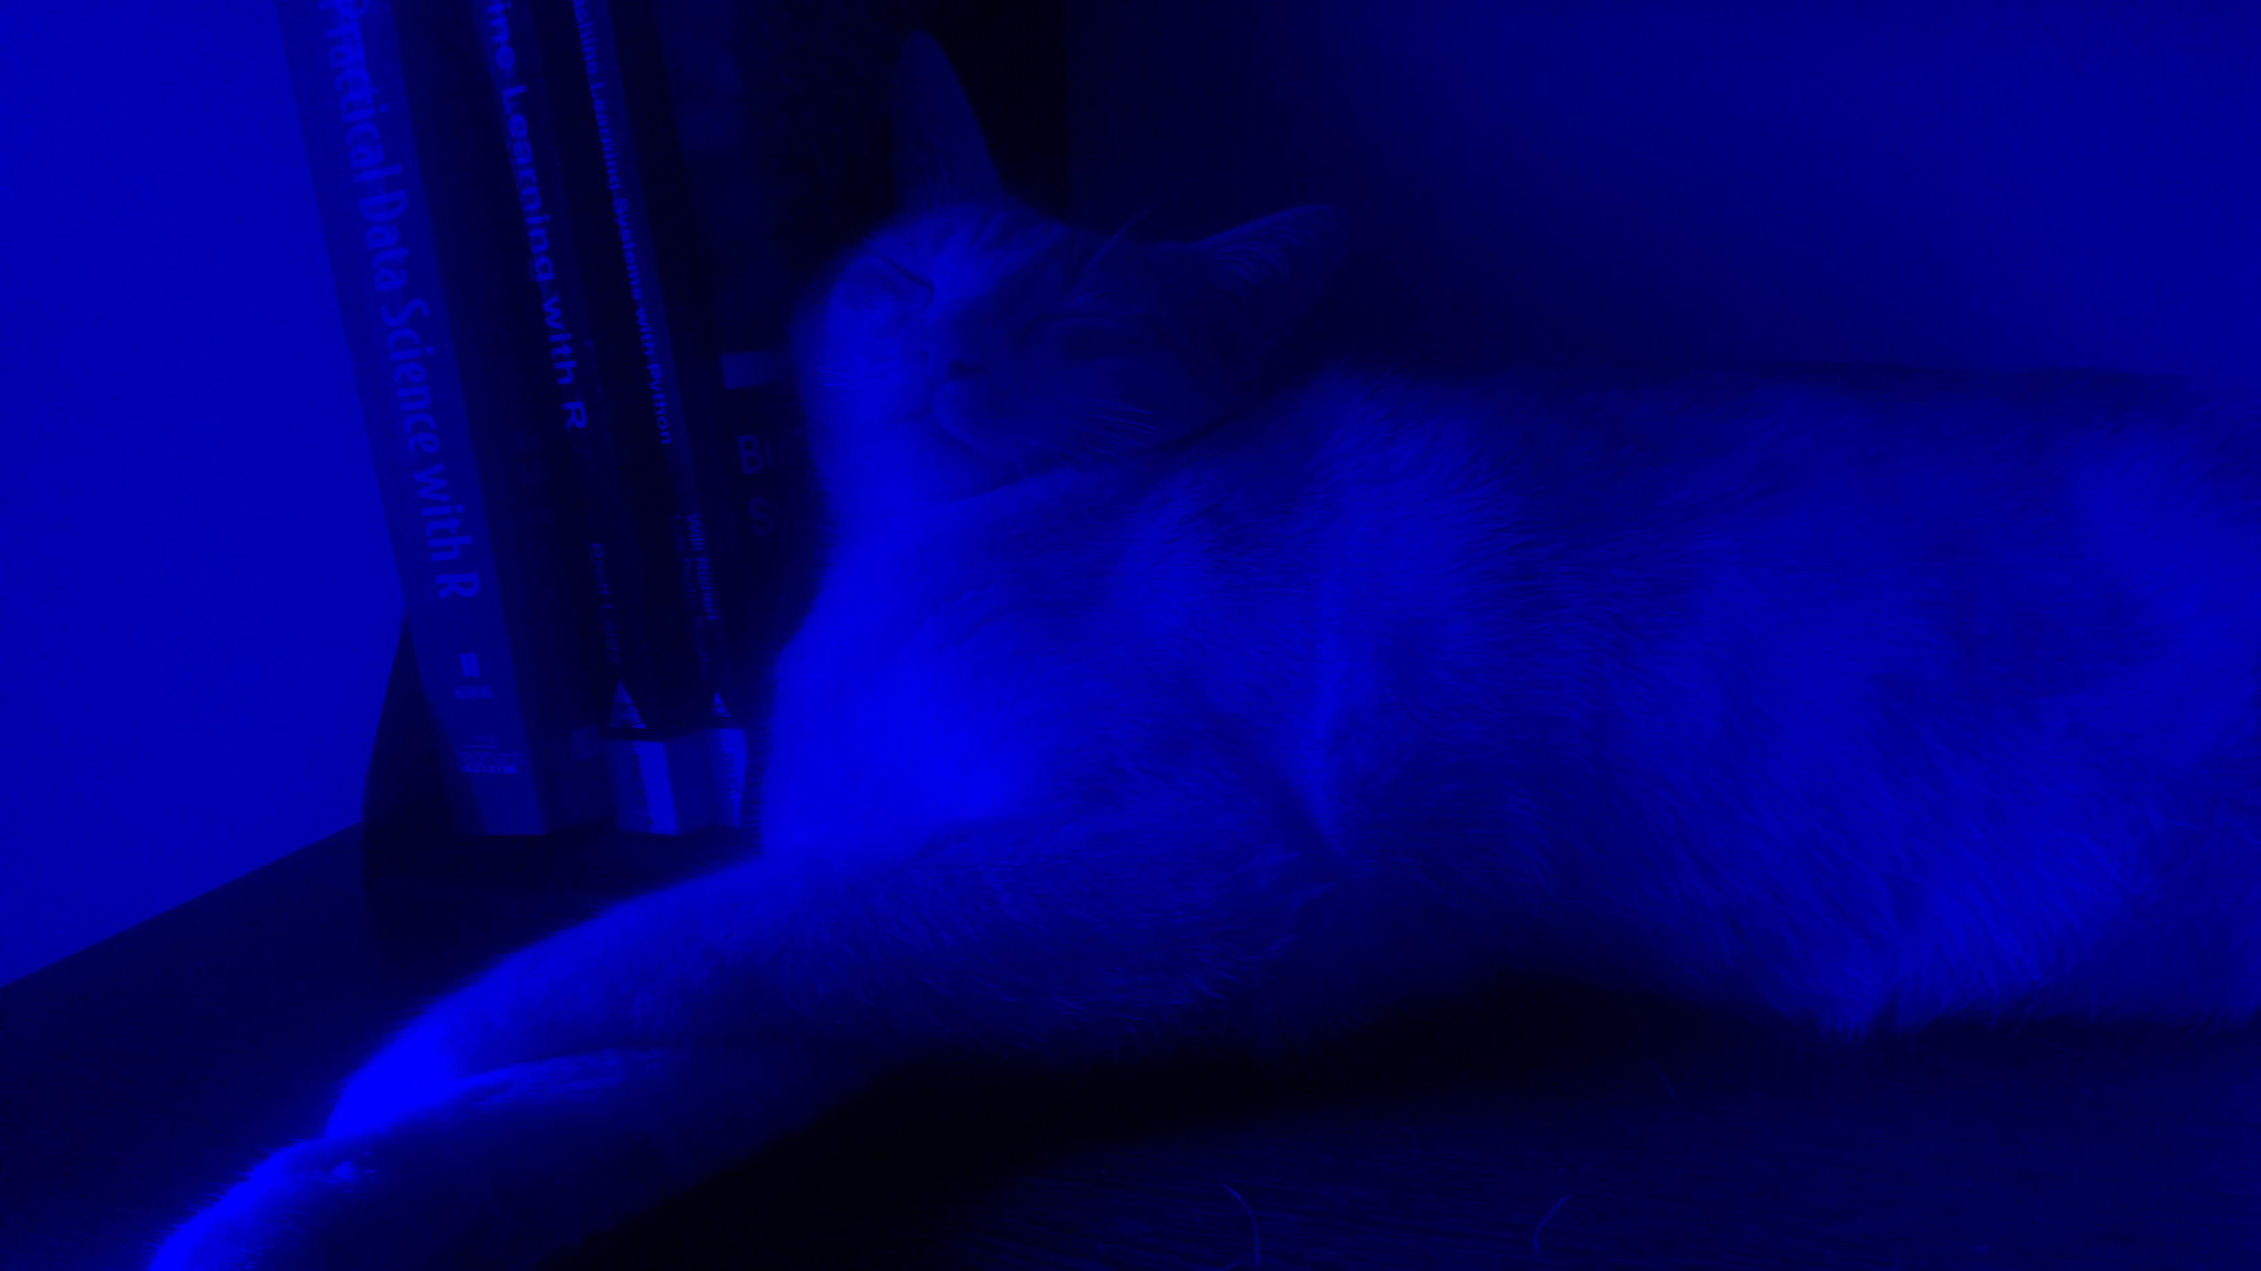

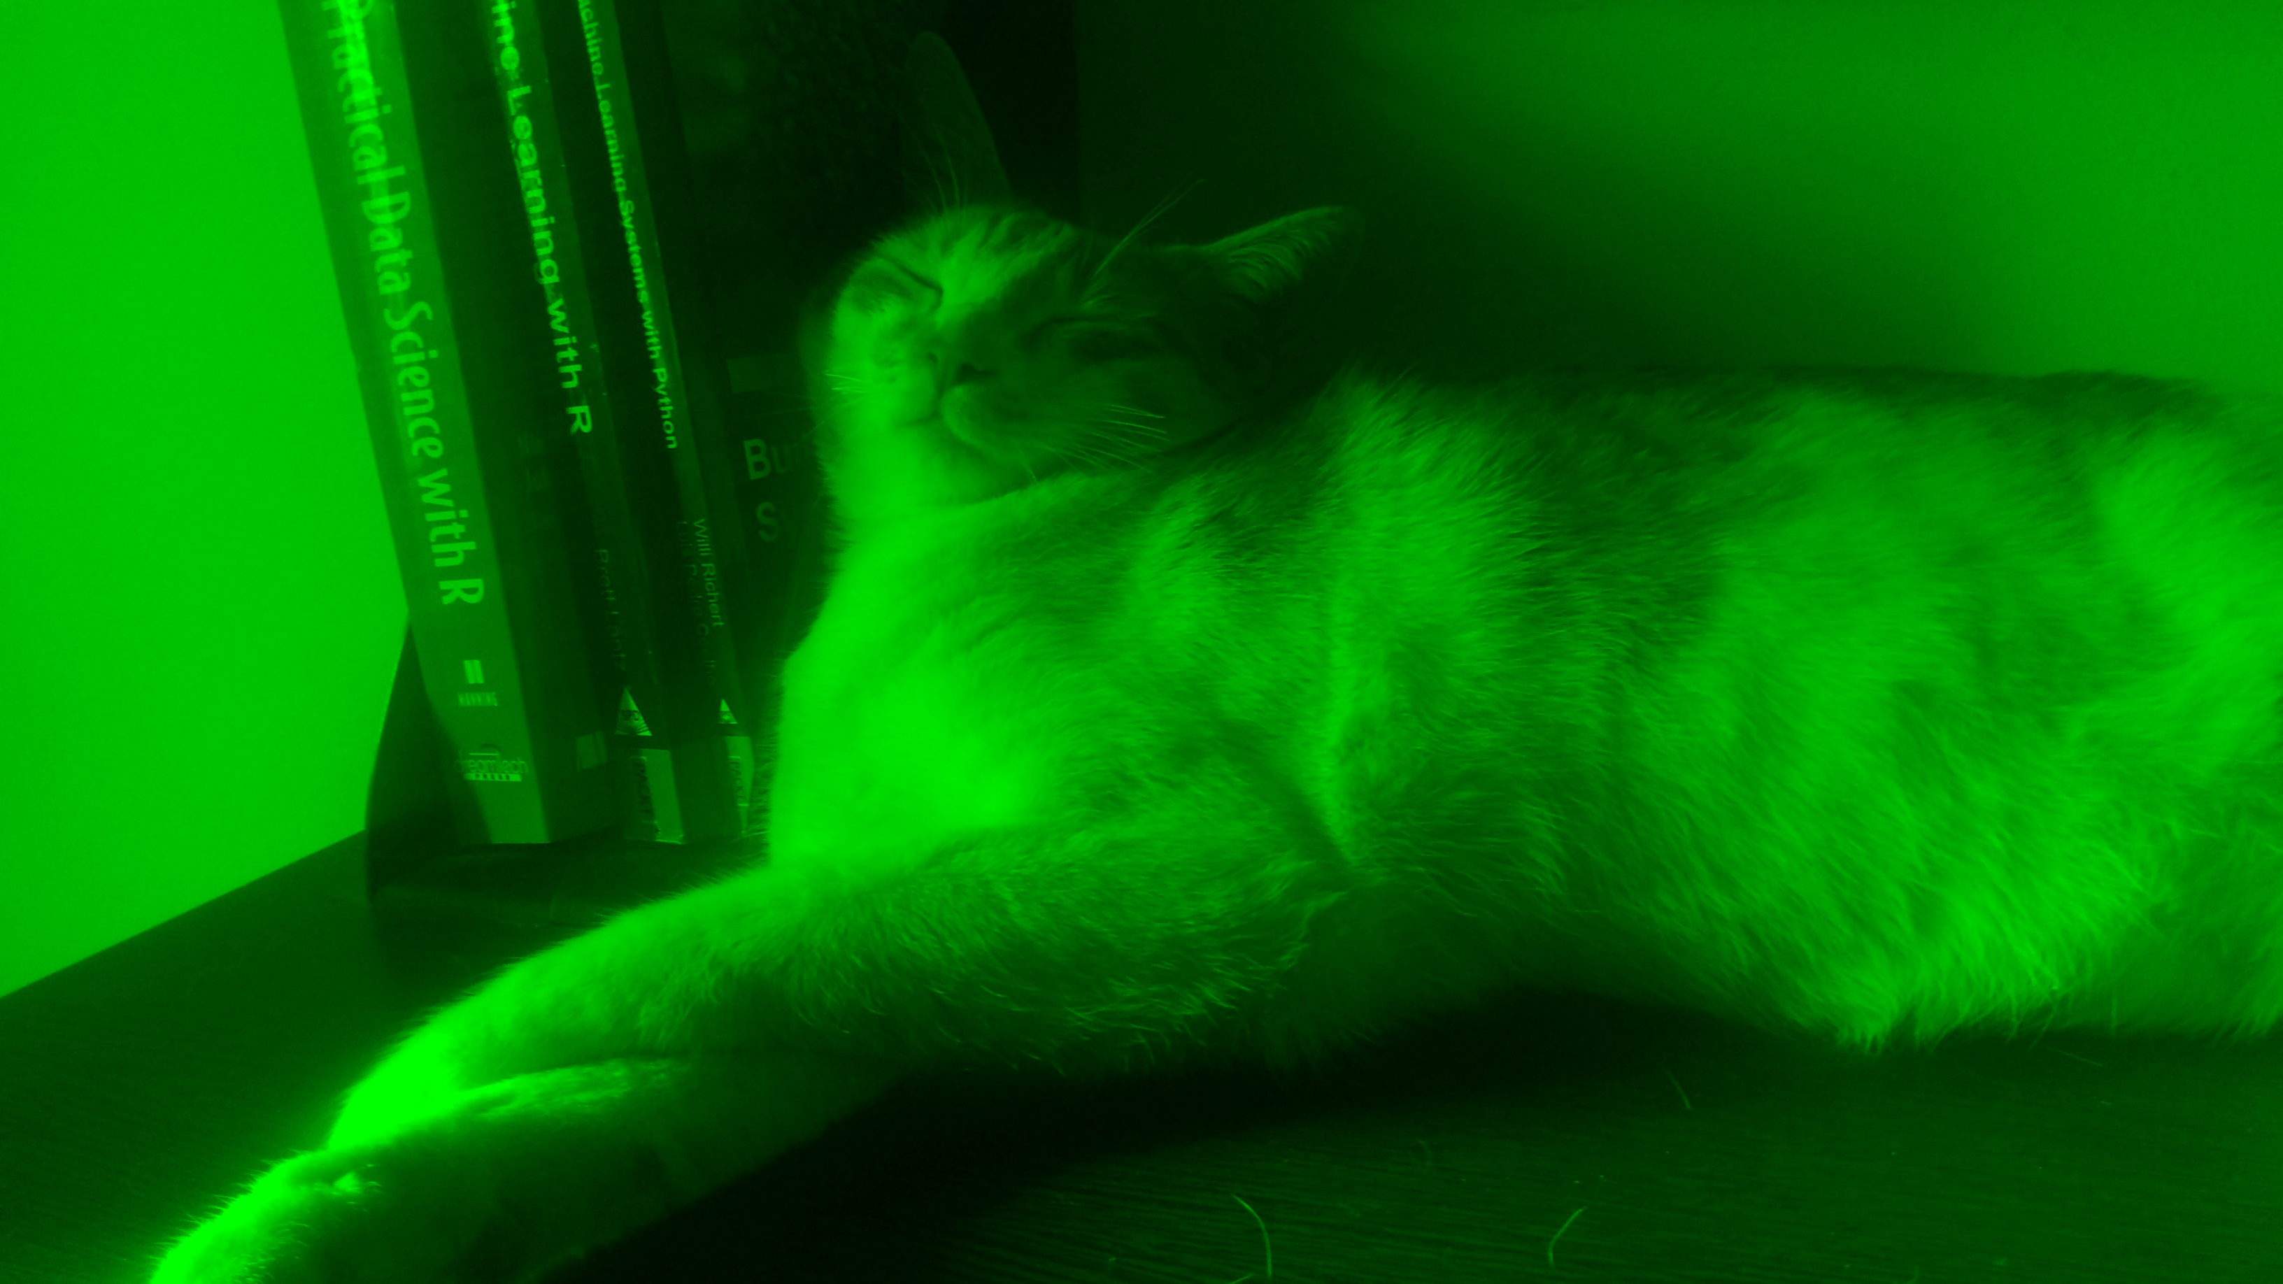

How images are stored

Slide 5
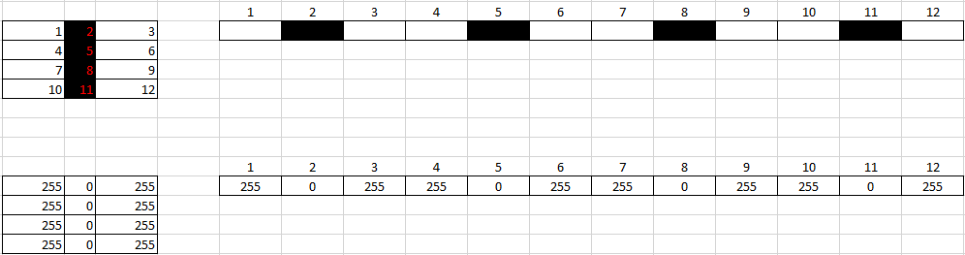
Flattening images
One way of preparing data for machine learning is to flatten images

Slide 6

Flattening images
Image 1
$$m×n$$

Slide 7

Flattening images
Image 1
Flatten
Flattened Image
$$1×mn$$
$$m×n$$

Slide 8


Flattening images
Image 1
Flatten
Flattened Image
$$1×80$$
$$8×10$$

Slide 9


Flattening images
Image 1
Flatten
Flattened Image
$$1×80$$
$$8×10$$
Image 2
Flatten
Flattened Image
$$1×80$$
$$8×10$$

Slide 10
Flattening images
Image 1
Flatten
Flattened Image
$$1×80$$
$$8×10$$
Image 2
Flatten
Flattened Image
$$1×80$$
$$8×10$$
Image 3
Flatten
Flattened Image
$$1×80$$
$$8×10$$

Slide 11
Flattening images
Predictor Matrix
Image 1
Flatten
Flattened Image
$$1×80$$
$$8×10$$
Image 2
Flatten
Flattened Image
$$1×80$$
$$8×10$$
Image 3
Flatten
Flattened Image
$$1×80$$
$$8×10$$

